Slide 1

ONLINE SHOPPING
Presented by:
ANSHIKA
AYUSHI
CHAITRA
SAINATH
VAIBHAV
Notes:
Add instructor notes here.

Slide 2
CONTENTS
INTRODUCTION
OBJECTIVE
CASE STUDY DIAGRAMS
TABLES
SCREENS
FUTURE SCOPE
CONCLUSION
Notes:
Add instructor notes here.

Slide 3

INTRODUCTION
This is a small scale venture for Online shopping framework. The fundamental thought is that client's can purchase items utilizing on the web.
It consists of product details, security system, status and exits.
The administrator can enter the name and password and generate the report and can perform operations like add , search, delete the products in the database.
Notes:
Add instructor notes here.

Slide 4
OBJECTIVES
The customers can buy product from anywhere, any time.
The database will maintain the customer’s and product details, information.
This Online shopping system involves with two types of users:
Customer
Administrator
Notes:
Add instructor notes here.

Slide 5
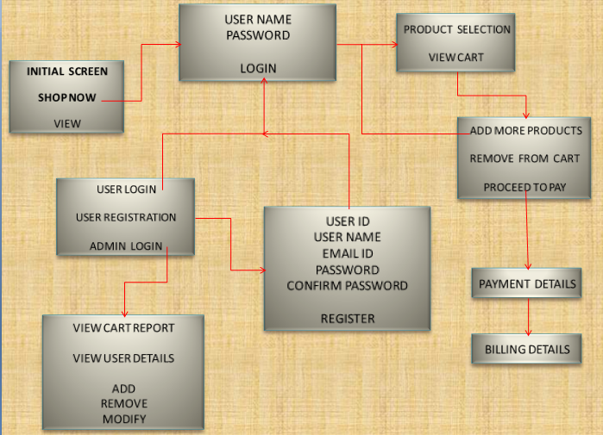
CASE STUDY DIAGRAM

Slide 6
TABLES
REGISTRATION
CATEGORY
SUB CATEGORY
ORDER
ORDER DETAILS
ADMIN
PRODUCT
Notes:
Add the notes here.
Add instructor notes here.

Slide 7
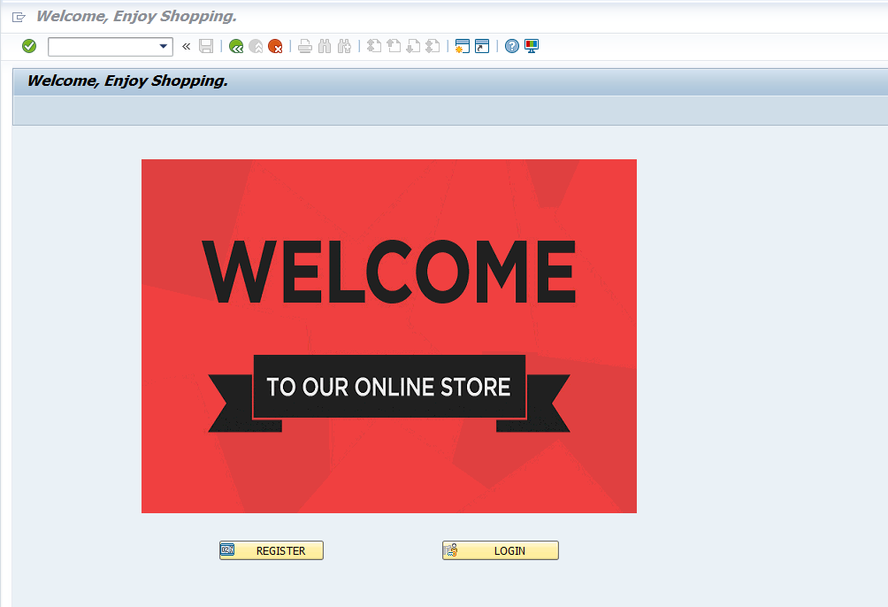
SCREENS
WELCOME SCREEN
LOGIN SCREEN
USER LOGIN
ADMIN LOGIN
USER SELECTION SCREEN
CUSTOMER CART SCREEN
CUSTOMER DETAILS SCREEN
ONLINE PAYMENT SCREEN
ADMIN MAIN SCREEN
VIEW CARD REPORT SCREEN
VIEW USER DETAILS SCREEN
MODIFY PRODUCT SCREEN

Slide 8
X.X: [Topic] <Slide Name in Short: Diagram>
Use this slide in case of illustrations
Notes:
Add the notes here.
Add instructor notes here.

Slide 9
X.X: [Topic] <Slide Name in Short: Chart>
Notes:
Add the notes here.
Add instructor notes here.

Slide 10
Summary
Summarize the topic in bullet points
Notes:
Add the notes here.
Add instructor notes here.

